Slide 1
FOFE-based Local Detection for NER
ACL 2017
宁时贤
2017-08-07

Slide 2
摘要
该论文针对命名实体识别任务提出了一种新颖的解决方式，将序列标注问题转换为一种对输入文本中的文本片段进行分类的方式识别实体。
→ 通过固定窗口的方式获得输入文本中的各片段，然后利用片段的上下文背景信息及片段本身信息对片段进行实体分类。该方法在几个公开的实体识别数据中获得了最优结果。
CoNLL 2003 NER task
TAC-KBP2015 and TAC-KBP2016 Trilingual Entity Discovery and Linking (EDL) tasks.
FOFE + FFNN

Slide 3
FOFE + FFNN方法概述
FOFE (Zhang et al., 2015 a,b)
FOFE (Fixed-size Ordinally-Forgetting Encoding)
用于编码片段本身及其上下文信息，得到固定长度的表示，解决变长句子的编码问题
FFNN（前馈神经网络）
a simple feedforward neural network
We apply a DNN on top of FOFE-based features.
降低模型复杂度
提高训练速度甚至整体效果

Slide 4
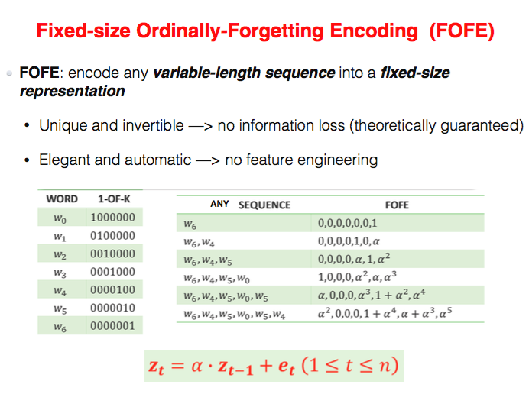
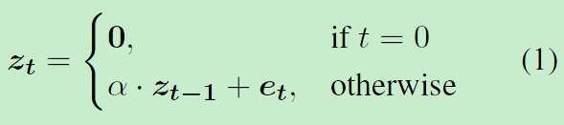
FOFE
FOFE是一种简单精妙的rule-base编码方式
优点：
FOFE is capable of uniquely encoding any sequence of arbitrary length, serving as a fixed-size but theoretically lossless representation for any sequence.
theoretically lossless

Slide 5
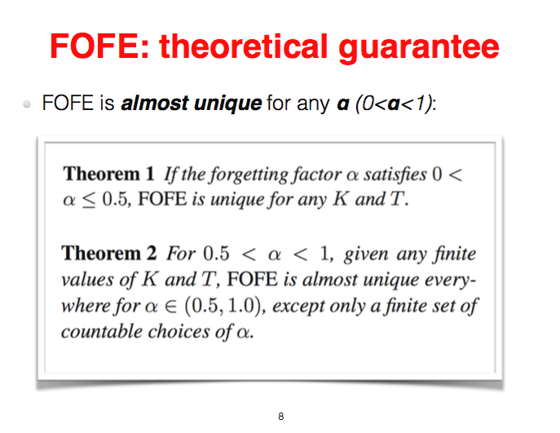
FOFE 理论证明

Slide 6
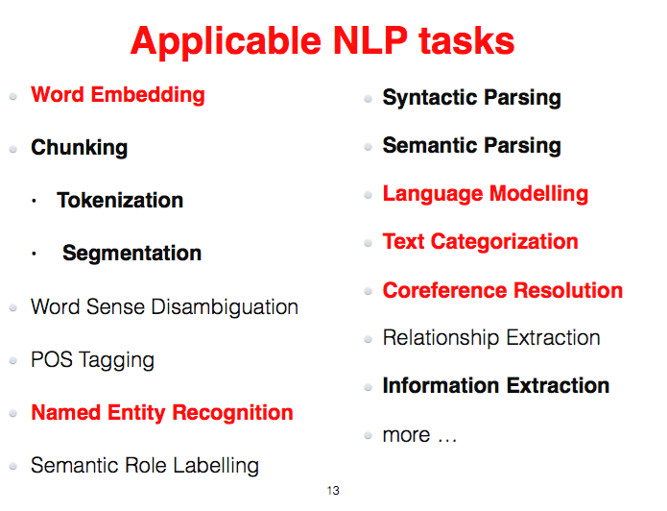
FOFE 应用

Slide 7
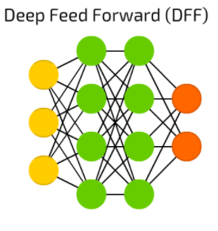
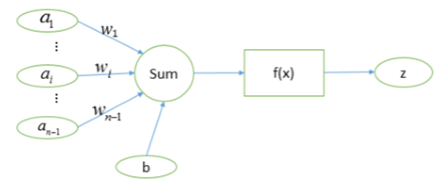
FFNN

Slide 8

NER例子
NER is formulated as a sequence labeling problem, where a tag is sequentially assigned to each word in the input sentence.

Slide 9
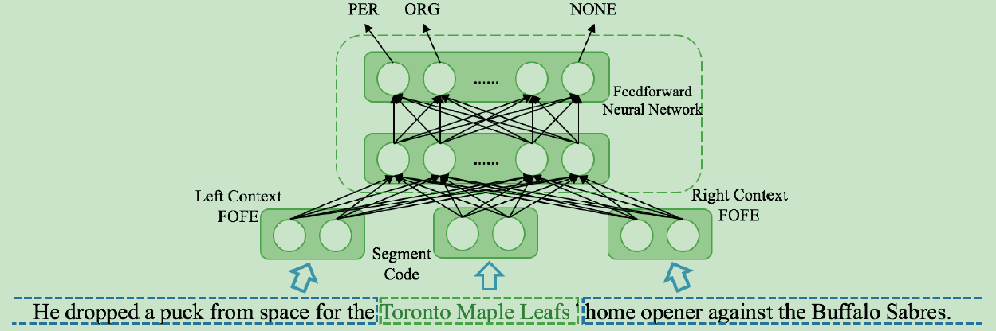
proposed FOFENER method

Slide 10
FOFE-NER
FOFE-NER method based on word segments (up to a certain length) and its left and right contexts in a sentence.
Whether a fragment is an entity or not, and what class it may belong to, largely depend on the internal structure of the fragment itself as well as the left and right contexts in which it appears.
In this work, we propose to use FOFE method to encode the segment and its contexts into some fixed-size representations. And then a FFNN can be trained to make a precise recognition for each individual word segment.

Slide 11
FOFE-NER
In this work, we use FOFE to explore both word-level and character-level features for each fragment and its contexts.
Word-level Features
Initialized by word embeddings trained by word2vec
Character-level Features
to further model its morphological structure
character embedding is randomly initialized and fine-tuned during model training.
双向

Slide 12
模型优点
Firstly, feature engineering is almost eliminated.
Secondly, under this local detection framework, nested mention is handled with little modification.
Next, it makes better use of partially-labeled data
At last, due to the simplicity of FOFE, simple neural networks, such as multilayer perceptrons, much faster to train and easier to tune.

Slide 13
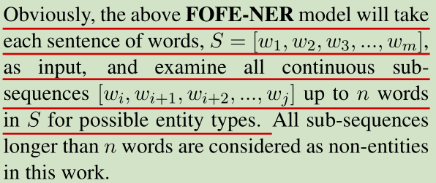
Training and Decoding Algorithm

Slide 14
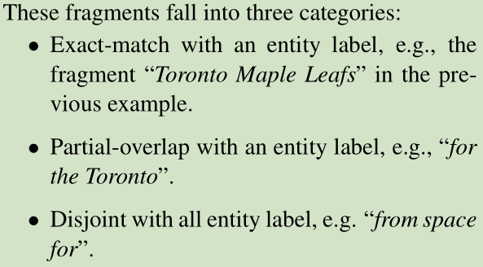
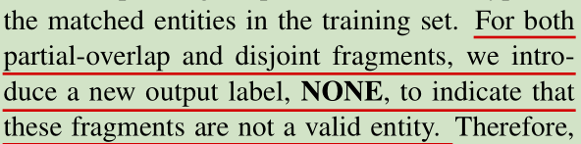
Training and Decoding Algorithm

Slide 15
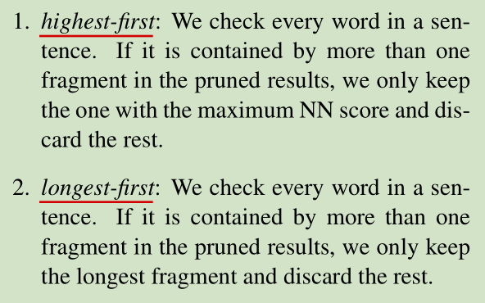
post-processing methods

Slide 16
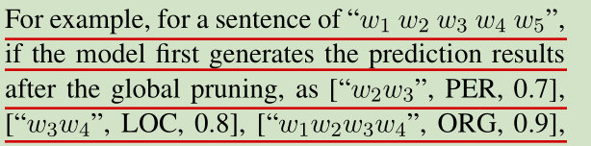
后处理举例

Slide 17
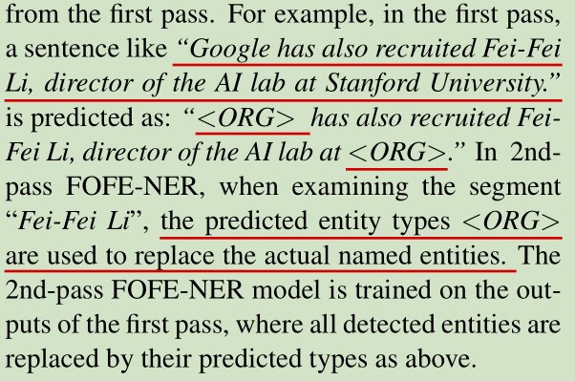
Second-Pass Augmentation

Slide 18
Experiments
CoNLL 2003 NER task
location (LOC), organization (ORG), person (PER), and miscellaneous (MISC).
hyper-parameters
Learning rate | 0.128 (每次迭代递减)
activation | ReLU
Character embeddings | 64 dimensions randomly initialized
Dropout rate | 0.4 (每次迭代递减)
Number of epochs | 128
word embeddings | 256 dimensions
Forgetting factor α | α = 0.5

Slide 19
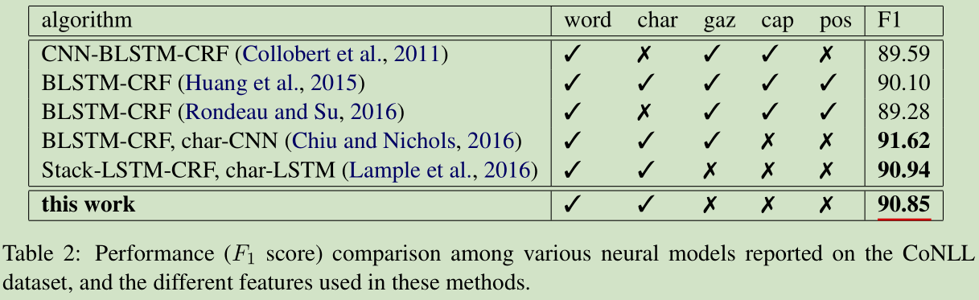
Experiments

Slide 20
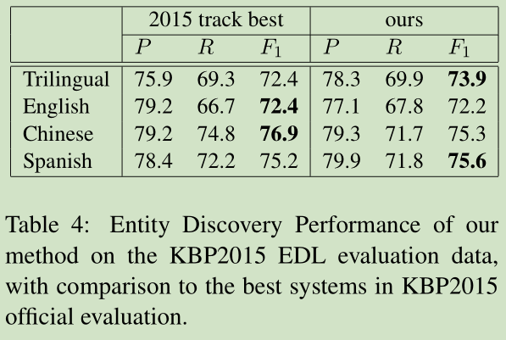
KBP2015 EDL evaluation

Slide 21
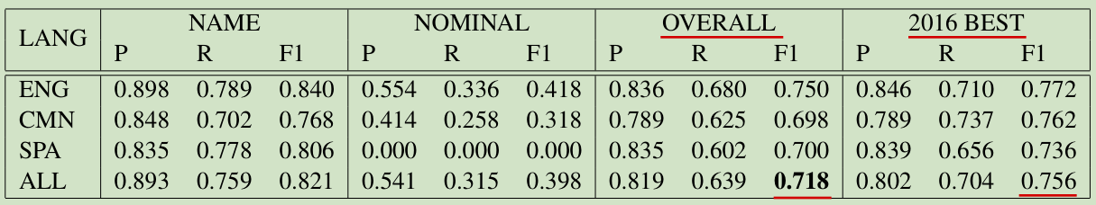
KBP2016 trilingual EDL track

Slide 22
Conclusion
Applying FFNN on top of FOFE features
Without using any external knowledge or feature engineering
Achieved almost state-of-the-art performance

